Slide 1
Software Design
Prof. R. Mall
Dept. of CSE, IIT, Kharagpur

Slide 2

What does designer do during design phase?
Transform SRS document to Design document:
  A form easily implementable in some programming language.
SRS Document
Design Documents
Design Activities

Slide 3
Items Designed During Design Phase
Module structure,
Control relationship among the modules
  call relationship or invocation relationship
Interface among different modules,
  data items exchanged among different modules,
Data structures of individual modules,
algorithms for individual modules.

Slide 4
Module
A module consists of:
  several functions
  associated data structures.
D1 ..
D2 ..
Data
D3 ..
F1 ..
Functions
F2 ..
F3 ..
F4 ..
F5 ..

Slide 5
Module Structure

Slide 6
Iterative Nature of Design
Good software designs:
  seldom arrived through a single step procedure:
  but through a series of steps and iterations.

Slide 7
Stages in Design
Design activities are usually classified into two stages:
  preliminary (or high-level) design
  detailed design.
Meaning and scope of the two stages:
  vary considerably from one methodology to another.

Slide 8
High-level design
Identify:
  modules
  control relationships among modules
  interfaces among modules.
d1
d2
d3
d1
d4

Slide 9
High-level design
The outcome of high-level design:
  program structure, also called software architecture.

Slide 10
High-level Design
Several notations are available to represent high-level design:
  Usually a tree-like diagram called structure chart is used.
  Other notations:
    Jackson diagram or Warnier-Orr diagram can also be used.

Slide 11
Detailed design
For each module, design:
  data structure
  algorithms
Outcome of detailed design:
  module specification.

Slide 12
A fundamental question
How to distinguish between good and bad designs?
  Unless we know what a good software design is:
    we can not possibly design one.

Slide 13
Good and bad designs
There is no unique way to design a software.
Even while using the same design methodology:
  different engineers can arrive at very different design solutions.
We need to distinguish between good and bad designs.

Slide 14
What Is Good Software Design?
Should implement all functionalities of the system correctly.
Should be easily understandable.
Should be efficient.
Should be easily amenable to change,
  i.e. easily maintainable.

Slide 15
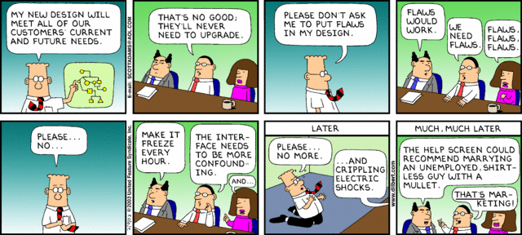
Dilbert: Scott Adams

Slide 16
What Is Good Software Design?
Understandability of a design is a major issue:
  Largely determines goodness of design:
  a design that is easy to understand:
    also easy to maintain and change.

Slide 17
What Is Good Software Design?
Unless a design is easy to understand,
  Tremendous effort needed to maintain it
  We already know that about 60% effort is spent in maintenance.
If the software is not easy to understand:
  maintenance effort would increase many times.

Slide 18
How to Improve Understandability?
Use consistent and meaningful names
  for various design components,
Design solution should consist of:
  A set of well decomposed modules (modularity),
Different modules should be neatly arranged in a hierarchy:
  in a tree-like diagram.
  Called Layering

Slide 19
Modularity
Modularity is a fundamental attributes of any good design.
  Decomposition of a problem into a clean set of modules:
  Modules are almost independent of each other
  Based on divide and conquer principle.

Slide 20
Modularity
If modules are independent:
  modules can be understood separately,
    reduces the complexity greatly.
  To understand why this is so,
    remember that it is very difficult to break a bunch of sticks but very easy to break the sticks individually.

Slide 21
Layering
Superior
Inferior

Slide 22
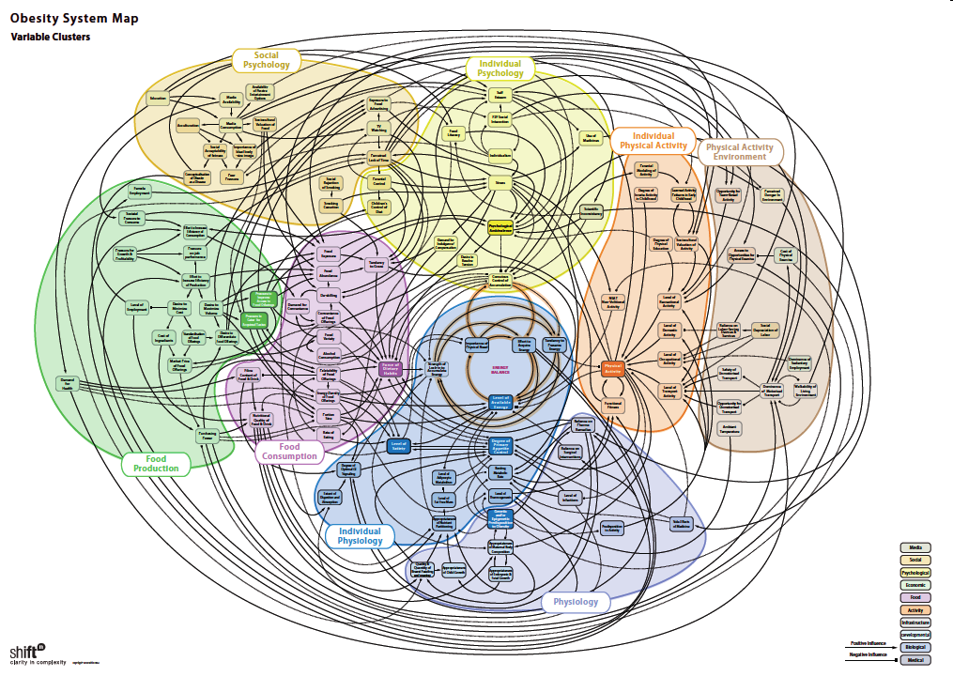
:Source

Slide 23
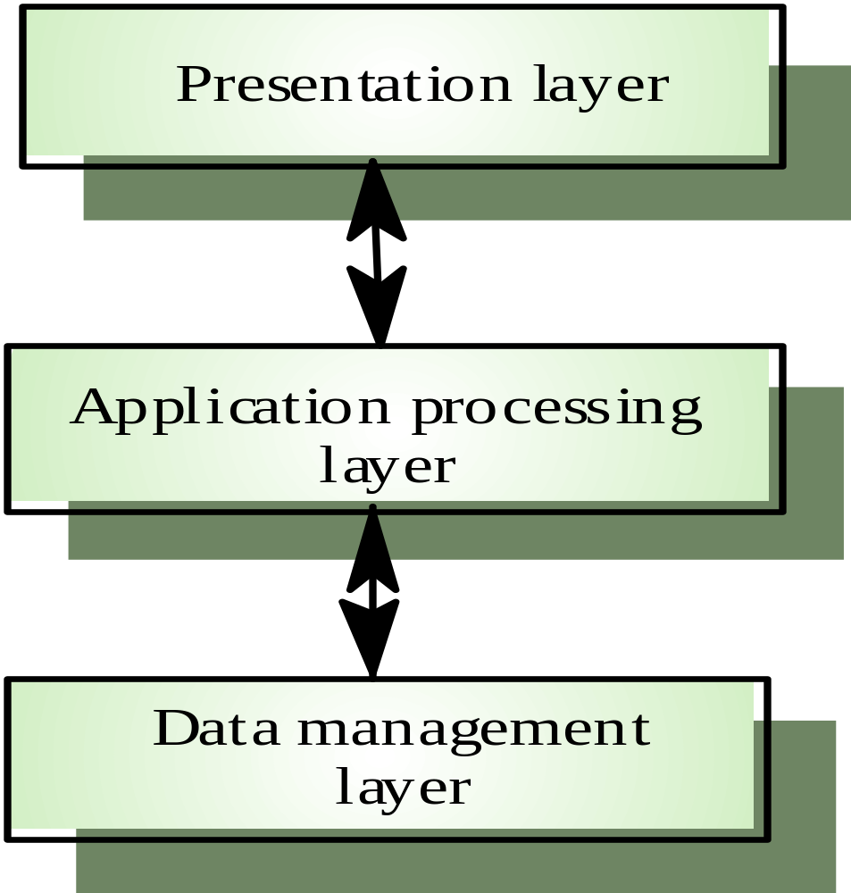
3-layer architectures of applications

Slide 24
Modularity
In technical terms, modules should display:
  high cohesion
  low coupling.
We nexts discuss:
  cohesion and coupling.

Slide 25
Modularity
Arrangement of modules in a hierarchy means:
  low fan-out
  abstraction

Slide 26
Coupling: Degree of dependence among components
No dependencies
Loosely coupled-some dependencies
High coupling makes modifying parts of the system difficult, e.g., modifying a component affects all the components to which the component is connected.
Highly coupled-many dependencies
Source:
Pfleeger, S., Software Engineering Theory and Practice. Prentice Hall, 2001.

Slide 27
Cohesion and Coupling
Cohesion is a measure of:
  functional strength of a module.
  A cohesive module performs a single task or function.
Coupling between two modules:
  A measure of the degree of interdependence or interaction between the two modules.

Slide 28
Cohesion and Coupling
A module having high cohesion and low coupling:
  Called functionally independent of other modules:
    A functionally independent module needs very little help from other modules and therefore has minimal interaction with other modules.

Slide 29
Advantages of Functional Independence
Better understandability and good design:
Complexity of design is reduced,
Different modules easily understood in isolation:
  modules are independent

Slide 30
Why Functional Independence is Advantageous
Functional independence reduces error propagation.
  degree of interaction between modules is low.
  an error existing in one module does not directly affect other modules.
Reuse of modules is possible.

Slide 31
Advantages of Functional Independence
A functionally independent module:
  can be easily taken out and reused in a different program.
    each module does some well-defined and precise function
    the interfaces of a module with other modules is simple and minimal.

Slide 32
Functional Independence
Unfortunately, there are no ways:
  to quantitatively measure the degree of cohesion and coupling:
  At least classification of different kinds of cohesion and coupling:
    will give us some idea regarding the degree of cohesiveness of a module.

Slide 33
Classification of Cohesiveness
Classification can have scope for ambiguity:
  yet gives us some idea about cohesiveness of a module.
By examining the type of cohesion exhibited by a module:
  we can roughly tell whether it displays high cohesion or low cohesion.

Slide 34
Classification of Cohesiveness
functional
sequential
communicational
Degree of
cohesion
procedural
temporal
logical
coincidental

Slide 35
Coincidental cohesion
The module performs a set of tasks:
  which relate to each other very loosely, if at all.
    That is, the module contains a random collection of functions.
    functions have been put in the module out of pure coincidence without any thought or design.

Slide 36
Coincidental Cohesion - example
Module AAA{
Print-inventory();
Register-Student();
Issue-Book();
};

Slide 37
Logical cohesion
All elements of the module perform similar operations:
  e.g. error handling, data input, data output, etc.
An example of logical cohesion:
  a set of print functions to generate an output report arranged into a single module.

Slide 38
Logical Cohesion
Module print{
void print-grades(student-file){ …}
void print-certificates(student-file){…}
void print-salary(teacher-file){…}
}

Slide 39
Temporal cohesion
The module contains tasks so that:
  all the tasks must be executed in the same time span.
Example:
  The set of functions responsible for
    initialization,
    start-up, shut-down of some process, etc.

Slide 40
Temporal Cohesion – Example
init() {
Check-memory();
Check-Hard-disk();
Initialize-Ports();
Display-Login-Screen();
}

Slide 41
Procedural cohesion
The set of functions of the module:
  all part of a procedure (algorithm)
  certain sequence of steps have to be carried out in a certain order for achieving an objective,
    e.g. the algorithm for decoding a message.

Slide 42
Communicational cohesion
All functions of the module:
  reference or update the same data structure,
Example:
  the set of functions defined on an array or a stack.

Slide 43
Communicational Cohesion
handle-Student- Data() {
Static Struct Student-data[10000];
Store-student-data();
Search-Student-data();
Print-all-students();
};
Function A
Function B
Function C
Communicational
Access same data

Slide 44
Sequential cohesion
Elements of a module form different parts of a sequence,
  output from one element of the sequence is input to the next.
  Example:
sort
search
display

Slide 45
Functional cohesion
Different elements of a module cooperate:
  to achieve a single function,
  e.g. managing an employee's pay-roll.
When a module displays functional cohesion,
  we can describe the function using a single sentence.

Slide 46
Determining Cohesiveness
Write down a sentence to describe the function of the module
  If the sentence is compound,
    it has a sequential or communicational cohesion.
  If it has words like “first”, “next”, “after”, “then”, etc.
    it has sequential or temporal cohesion.
  If it has words like initialize,
    it probably has temporal cohesion.

Slide 47
Coupling
Coupling indicates:
  how closely two modules interact or how interdependent they are.
  The degree of coupling between two modules depends on their interface complexity.

Slide 48
Coupling
There are no ways to precisely measure coupling between two modules:
  classification of different types of coupling will help us to approximately estimate the degree of coupling between two modules.
Five types of coupling can exist between any two modules.

Slide 49
Classes of coupling
data
stamp
control
Degree of
coupling
common
content

Slide 50
Data coupling
Two modules are data coupled,
  if they communicate via a parameter:
    an elementary data item,
    e.g an integer, a float, a character, etc.
  The data item should be problem related:
    not used for control purpose.

Slide 51
Stamp coupling
Two modules are stamp coupled,
  if they communicate via a composite data item
    or an array or structure in C.

Slide 52
Control coupling
Data from one module is used to direct
  order of instruction execution in another.
Example of control coupling:
  a flag set in one module and tested in another module.

Slide 53
Common Coupling
Two modules are common coupled,
  if they share some global data.

Slide 54
Content coupling
Content coupling exists between two modules:
  if they share code,
  e.g, branching from one module into another module.
The degree of coupling increases
  from data coupling to content coupling.

Slide 55
Hierarchical Design
Control hierarchy represents:
  organization of modules.
  control hierarchy is also called program structure.
Most common notation:
  a tree-like diagram called structure chart.

Slide 56
Good Hierachical Arrangement of modules
Essentially means:
  low fan-out
  abstraction

Slide 57
Characteristics of Module Structure
Depth:
  number of levels of control
Width:
  overall span of control.
Fan-out:
  a measure of the number of modules directly controlled by given module.

Slide 58
Characteristics of Module Structure
Fan-in:
  indicates how many modules directly invoke a given module.
  High fan-in represents code reuse and is in general encouraged.

Slide 59
Module Structure
Fan out=2
Fan out=1
Fan in=1
Fan in=2
Fan out=0

Slide 60
Goodness of Design
A design having modules:
  with high fan-out numbers is not a good design:
  a module having high fan-out lacks cohesion.

Slide 61
Large Fan Out
A module that invokes a large number of other modules:
  likely to implement several different functions:
  not likely to perform a single cohesive function.

Slide 62
Control Relationships
A module that controls another module:
  said to be superordinate to it.
Conversely, a module controlled by another module:
  said to be subordinate to it.

Slide 63
Visibility and Layering
A module A is said to be visible by another module B,
  if A directly or indirectly calls B.
The layering principle requires
  modules at a layer can call only the modules immediately below it.

Slide 64
Bad Design

Slide 65
Abstraction
Lower-level modules:
  do input/output and other low-level functions.
Upper-level modules:
  do more managerial functions.

Slide 66
Abstraction
The principle of abstraction requires:
  lower-level modules do not invoke functions of higher level modules.
  Also known as layered design.

Slide 67
High-level Design
High-level design maps functions into modules {fi} → {mj} such that:
  Each module has high cohesion
  Coupling among modules is as low as possible
  Modules are organized in a neat hierarchy

Slide 68
High-level Design
f1
f2
d1
d2
f3
•
d3
d1
d4
•
•
fn

Slide 69
Design Approaches
Two fundamentally different software design approaches:
  Function-oriented design
  Object-oriented design

Slide 70
Design Approaches
These two design approaches are radically different.
  However, are complementary
    rather than competing techniques.
  Each technique is applicable at
    different stages of the design process.

Slide 71
Function-Oriented Design
A system is looked upon as something
  that performs a set of functions.
Starting at this high-level view of the system:
  each function is successively refined into more detailed functions (top-down decomposition).
  Functions are mapped to a module structure.

Slide 72
Example
The function create-new-library- member:
  creates the record for a new member,
  assigns a unique membership number
  prints a bill towards the membership

Slide 73
Function-Oriented Design
The system state is centralized:
  accessible to different functions,
  member-records:
    available for reference and updation to several functions:
      create-new-member
      delete-member
      update-member-record

Slide 74
Function-Oriented Design
Several function-oriented design approaches have been developed:
  Structured design (Constantine and Yourdon, 1979)
  Jackson's structured design (Jackson, 1975)
  Warnier-Orr methodology
  Wirth's step-wise refinement
  Hatley and Pirbhai's Methodology

Slide 75
Example
Create-library-member function consists of the following sub-functions:
  assign-membership-number
  create-member-record
  print-bill
Split these into further subfunctions, etc.

Slide 76
Object-Oriented Design
System is viewed as a collection of objects (i.e. entities).
System state is decentralized among the objects:
  each object manages its own state information.

Slide 77
Object-Oriented Design Example
Library Automation Software:
  each library member is a separate object
    with its own data and functions.
  Functions defined for one object:
    cannot directly refer to or change data of other objects.

Slide 78
Object-Oriented Design
Objects have their own internal data:
  defines their state.
Similar objects constitute a class.
  each object is a member of some class.
Classes may inherit features
  from a super class.
Conceptually, objects communicate by message passing.

Slide 79
Object-Oriented versus Function-Oriented Design
Unlike function-oriented design,
  in OOD the basic abstraction is not functions such as “sort”, “display”, “track”, etc.,
  but real-world entities such as “employee”, “picture”, “machine”, “radar system”, etc.

Slide 80
Object-Oriented versus Function-Oriented Design
In OOD:
  software is not developed by designing functions such as:
    update-employee-record,
    get-employee-address, etc.
  but by designing objects such as:
    employees,
    departments, etc.

Slide 81
Object-Oriented versus Function-Oriented Design
Grady Booch sums up this fundamental difference saying:
  “Identify verbs if you are after procedural design and nouns if you are after object-oriented design.”

Slide 82
Object-Oriented versus Function-Oriented Design
In OOD:
  state information is not shared in a centralized data.
  but is distributed among the objects of the system.

Slide 83
Example:
In an employee pay-roll system, the following can be global data:
  names of the employees,
  their code numbers,
  basic salaries, etc.
Whereas, in object oriented systems:
  data is distributed among different employee objects of the system.

Slide 84
Object-Oriented versus Function-Oriented Design
Objects communicate by message passing.
  one object may discover the state information of another object by interrogating it.

Slide 85
Object-Oriented versus Function-Oriented Design
Of course, somewhere or other the functions must be implemented:
  the functions are usually associated with specific real-world entities (objects)
  directly access only part of the system state information.

Slide 86
Object-Oriented versus Function-Oriented Design
Function-oriented techniques group functions together if:
  as a group, they constitute a higher level function.
On the other hand, object-oriented techniques group functions together:
  on the basis of the data they operate on.

Slide 87
Object-Oriented versus Function-Oriented Design
To illustrate the differences between object-oriented and function-oriented design approaches,
  let us consider an example ---
  An automated fire-alarm system for a large building.

Slide 88


Fire-Alarm System:
We need to develop a computerized fire alarm system for a large multi -storied building:
  There are 80 floors and 1000 rooms in the building.

Slide 89
Fire-Alarm System:
Different rooms of the building:
  fitted with smoke detectors and fire alarms.
The fire alarm system would monitor:
  status of the smoke detectors.

Slide 90
Fire-Alarm System
Whenever a fire condition is reported by any smoke detector:
  the fire alarm system should:
    determine the location from which the fire condition was reported
    sound the alarms in the neighboring locations.

Slide 91
Fire-Alarm System
The fire alarm system should:
  flash an alarm message on the computer console:
    fire fighting personnel man the console round the clock.

Slide 92
Fire-Alarm System
After a fire condition has been successfully handled,
  the fire alarm system should let fire fighting personnel reset the alarms.

Slide 93
Function-Oriented Approach:
/* Global data (system state) accessible by various functions */
BOOL detector_status[1000];
int detector_locs[1000];
BOOL alarm-status[1000]; /* alarm activated when set */
int alarm_locs[1000]; /* room number where alarm is located */
int neighbor-alarms[1000][10];/*each detector has at most*/
/* 10 neighboring alarm locations */
interrogate_detectors();
get_detector_location();
determine_neighbor();
ring_alarm();
reset_alarm();
report_fire_location();

Slide 94
Object-Oriented Approach:
class detector
attributes: status, location, neighbors
operations: create, sense-status, get-location,
find-neighbors
class alarm
attributes: location, status
operations: create, ring-alarm, get_location,
reset-alarm
  Appropriate number of instances of the class detector and alarm are created.

Slide 95
Object-Oriented versus Function-Oriented Design
In a function-oriented program :
  the system state is centralized
  several functions accessing these data are defined.
In the object oriented program,
  the state information is distributed among various sensor and alarm objects.

Slide 96
Object-Oriented versus Function-Oriented Design
Use OOD to design the classes:
  then applies top-down function oriented techniques
    to design the internal methods of classes.

Slide 97
Object-Oriented versus Function-Oriented Design
Though outwardly a system may appear to have been developed in an object oriented fashion,
  but inside each class there is a small hierarchy of functions designed in a top-down manner.

Slide 98
Summary
We started with an overview of:
  activities undertaken during the software design phase.
We identified:
  the information need to be produced at the end of design:
    so that the design can be easily implemented using a programming language.

Slide 99
Summary
We characterized the features of a good software design by introducing the concepts of:
  fan-in, fan-out,
  cohesion, coupling,
  abstraction, etc.

Slide 100
Summary
We classified different types of cohesion and coupling:
  enables us to approximately determine the cohesion and coupling existing in a design.

Slide 101
Summary
Two fundamentally different approaches to software design:
  function-oriented approach
  object-oriented approach

Slide 102
Summary
We examined the essential philosophy behind these two approaches
  these two approaches are not really competing but complementary approaches.

